Slide 1
Range Safety Certification Program
Updated February 23, 2023

Slide 2
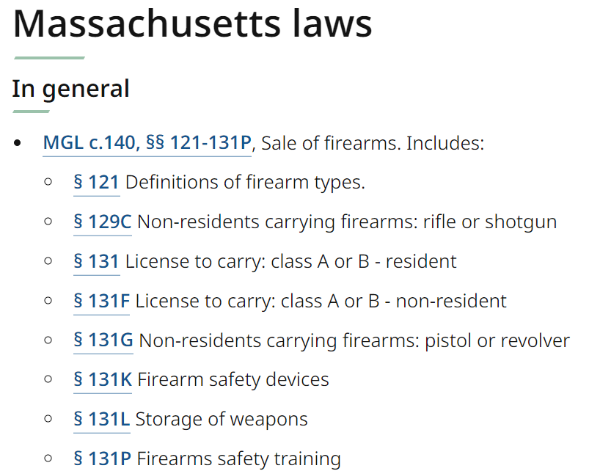
Range Safety Certification Program
Important Information Regarding Firearms on Club Property
Non-residents
Must adhere to all Mass Laws

Slide 3
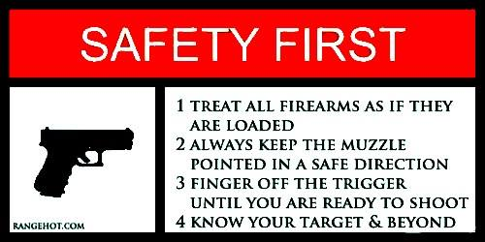
Agenda
Club-Wide Rules
Pistol Range Rules
Rifle Range Rules
Trap Range Rules

Slide 4
Club-wide rules
This is YOUR club, and ensuring a safe environment is everyone’s duty

Slide 5
Drugs & Alcohol
Absolutely no drug or alcohol use before or
during shooting activities, including bystanders
No one in possession of illegal drugs or
marijuana is allowed on club property
at any time

Slide 6
Range Times
Lighted Ranges
Monday-Saturday 8:00am-10:00pm
Sunday – 9:30am -4:00 pm or Sunset (whichever is earliest)
Non-Lighted Ranges
Monday-Saturday 8:00am – Sunset
Sunday – 9:30am -4:00 pm or Sunset (whichever is earliest)
Respect our neighbors by adhering to posted range times!
Please minimize rapid fire shooting

Slide 7
Appropriate Calibers & Ammunition
Pistol Range
Rifle Range
Calibers: .17 HM2 to .50
Firearms/Air guns: Handguns and pistol-caliber rifles/carbines
No Shotguns
Calibers/Gauges: .17HM2 to .50 (no BMG) & .410 to 12 gauge
Firearms/Air guns: Handguns, Rifles, & Shotguns
Trap Range is limited to 12 gauge shotguns or less
Armor piercing, incendiary, explosive or tracer ammunition is NOT allowed

Slide 8
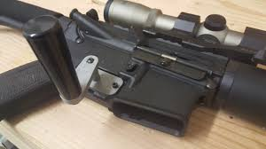
Rate of Fire
No “Uncontrolled Rapid Fire”
Rate of fire deemed inaccurate enough to be missing the intended target or berm, and is based on each individual’s skill level
No use of firearms in full-automatic or burst mode
No use of bump firing or full-automatic simulating devices such as:
Slide fire stocks
Tac-Con triggers
Crank-style trigger attachments

Slide 9
Guest Policy
Guests are always welcome on our property /ranges provided they adhere to the rules of HRGC and fall within the following :
Attending for the purpose of competing in a club sponsored event where the public is invited
Accompanied by a member for the purpose of observing
Accompanied by a member for the purpose of shooting when considering a membership (this will be allowed only twice per year for any Life, Family, or Adult membership)
Family members and relatives visiting from out of state when accompanied by a member

Slide 10
Is It Safe To Shoot?
BEFORE you commence shooting
Make sure everyone is wearing the proper Personal Protective Equipment (PPE) - Eye and Hearing Protection including spectators
Make sure no one is down range or in harm’s way
Announce your intent to shoot by asking if the firing line is ready
Remember that anyone can call a “cease fire” if needed

Slide 11
Before Anyone Proceeds Downrange
Announce “Cease Fire”
All shooters unload firearms completely
Magazines removed
Action open
Open Bolt Indicator Inserted (Zip-Tie maybe used)
Ensure proper signals (flag or lights) are in use
No firearms are to be handled with anyone down range
Everyone not down range should step behind the red line on the floor

Slide 12
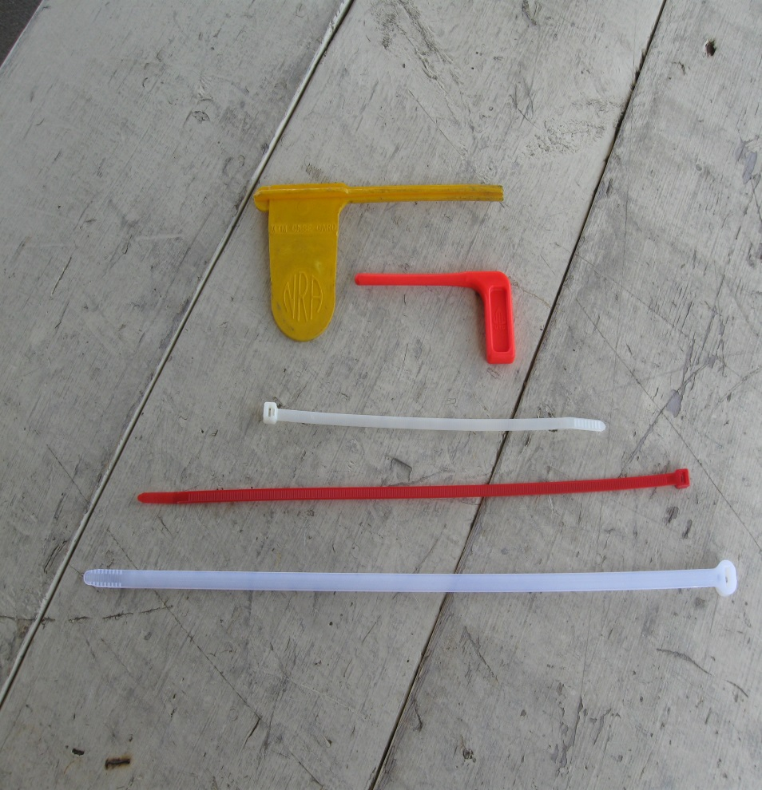
Open chamber Indicators – rifle/pistol
Open chamber indicators can be
either chamber flags
color contrasting tie wraps
weed whacker string
It is acceptable to remove the bolt on a bolt action rifle
can separate upper/lower AR

Slide 13
Shooting From Downrange Position
Shooting from a downrange position is allowed, but must be surrendered to any shooter wishing to shoot from the firing line. Be courteous and alternate positions if possible.
Utilize downrange signals (flag and/or lights) whenever shooting downrange
Pick up your casings/hulls/wads as best as possible upon completion of shooting
Pick up any live rounds ejected onto dirt or grass

Slide 14
Proper Targets
Proper personal targets consist of only paper, cardboard, and clay targets.
Only steel targets provided and placed by HRG are to be used on pistol range.
10 yards minimum distance for steel targets at pistol range
10 yards minimum for .22LR at rifle for steel targets
100 yards minimum to engage steel targets centerfire
All targets must be placed so that shots will directly impact the berm
Do not place targets ON the berm
Consider your trajectory!

Slide 15
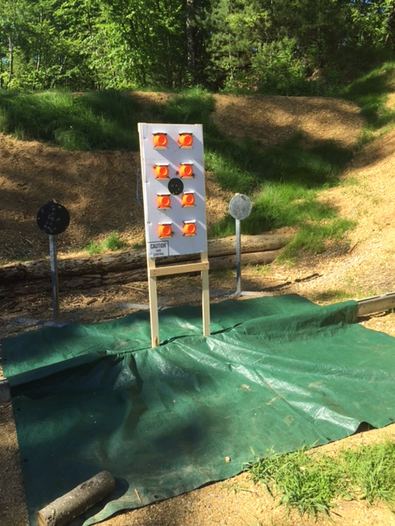
Proper stands and tarp set up for clay bird shooting
Pistol/Rife Range Clay Targets

Slide 16
Proper stands and tarp set up for clay bird shooting
Pistol/Rife Range Clay Targets
Approved clay target holder examples

Slide 17
When finished shooting
Pistol/Rife Range Clay Targets
Collect debris
Place in trash

Slide 18
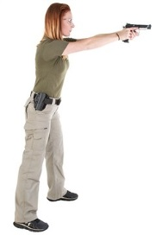
Understand Your Trajectory – Normal Shooting Positions VS Target Height and Distance from Berm
Potential Ricochet of Shot
Berm
Target too far from berm, round will not impact berm. (Target height may also be too low)
Berm
Correct Trajectory, round impacts berm. (Target is at the correct height and distance from the berm.)

Slide 19
Understand Your Trajectory – Low Shooting Positions VS Target Height and Distance from Berm
Shot Potential of Exiting The Range
Target too far from berm, round will not impact berm. (Target height may also be too high for your shooting position.)
Berm
Berm
Correct Trajectory, round impacts berm. (Target is at the correct height and distance from the berm.)

Slide 20
Enjoy the Ranges and Grounds
The hard work of past, present, and future members is at stake:
Please be safe!
Report suspect or unsafe conditions
Is that person next to you a member?
Follow the rules for paper, clay, and steel targets
Please volunteer - whether it be work parties, monetary donation, or simply picking up after yourself (and others if needed)
It’s your club, please treat it with respect!

Slide 21
This Is Your Club!
In addition to adhering to all safety rules yourself, please notify someone of any unsafe or questionable behavior
You do not need to confront them yourself, but please collect sign-in information and/or license plate number and report it to range chairman or the Board of Directors
If approaching someone about their behavior, please be respectful, reminding them it’s all about safety
Call 508-347-3389, option #5, Leave a detailed message, with contact information for HRGC Club Safety Committee.

Slide 22
This Is Your Club! Let's keep it!
Please Join GOAL - Protecting Your Freedom Begins Here
GOAL - Gun Owners Action League - GOAL.org
Consider joining the NRA or any other 2A groups

Slide 23
Pistol range
Pistol Range Layout and Pistol-Specific Rules
NOTE: All Firearms Must Remain Boxed, Cased and/or Holstered Until brought
to the Shooting Line and/or Bench. Once you are on the Firing Line, the Muzzle
Must remain pointed Down-Range at all times, breaking this Rule will result
in loss of ALL Shooting Range Access, per the BOD, Safety Committee and
discipline Chairmen.
NOTE: A Copy of these slides, is available for your review, located in the Sign-in desk.
February 2023

Slide 24
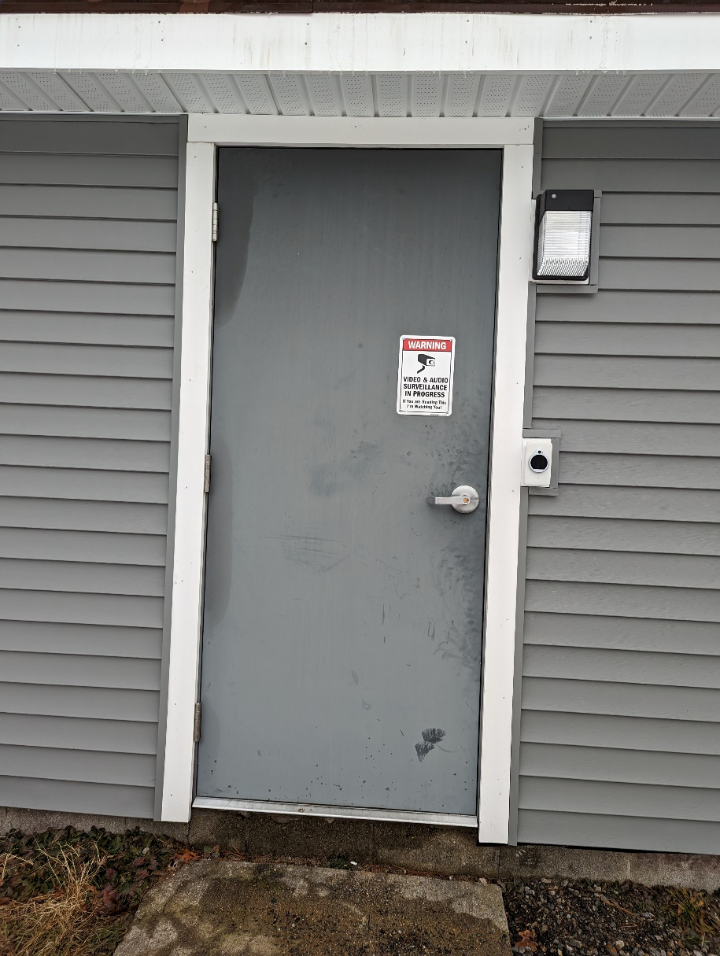
Pistol range Entrance
Pistol Range Badge Reader
You Must Have Completed the Clubs Mandatory Safety Briefing to Have Access!

Slide 25
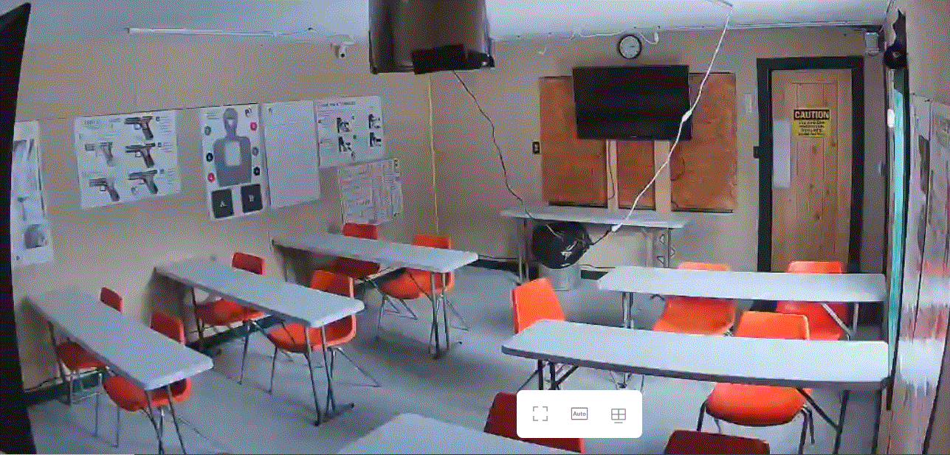
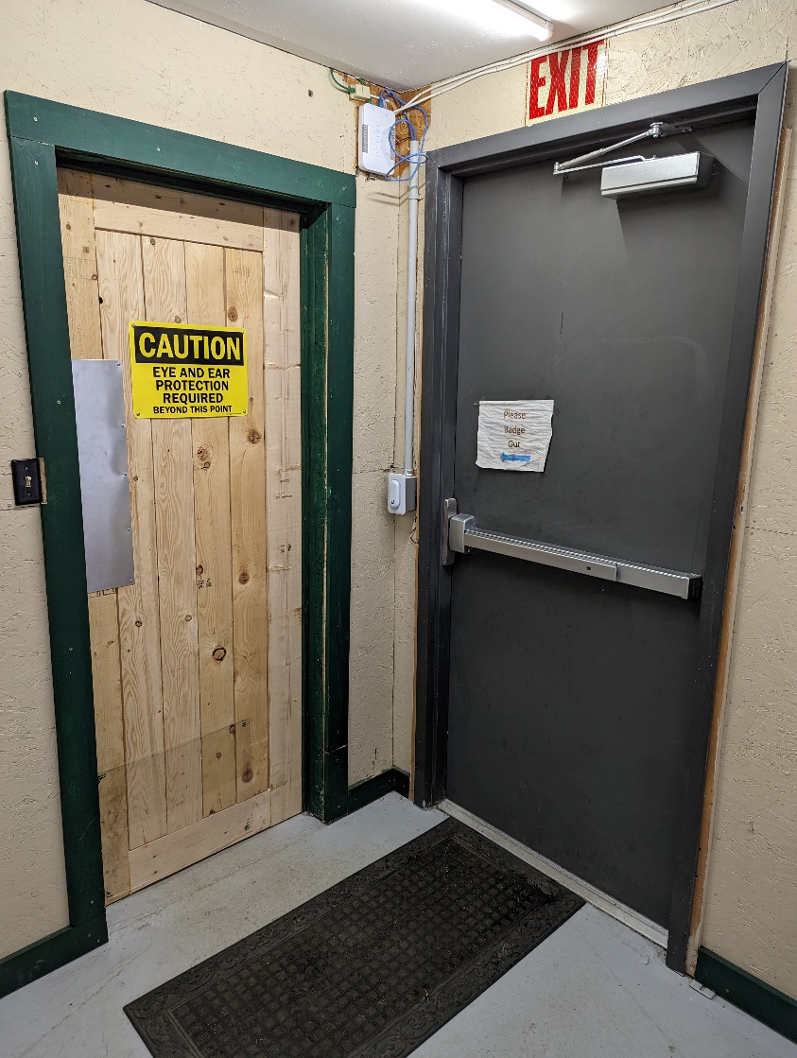
Pistol Range
Note: Required Protection
When Entering The Range
Inside Training Room
When leaving remember to always Badge out!

Slide 26
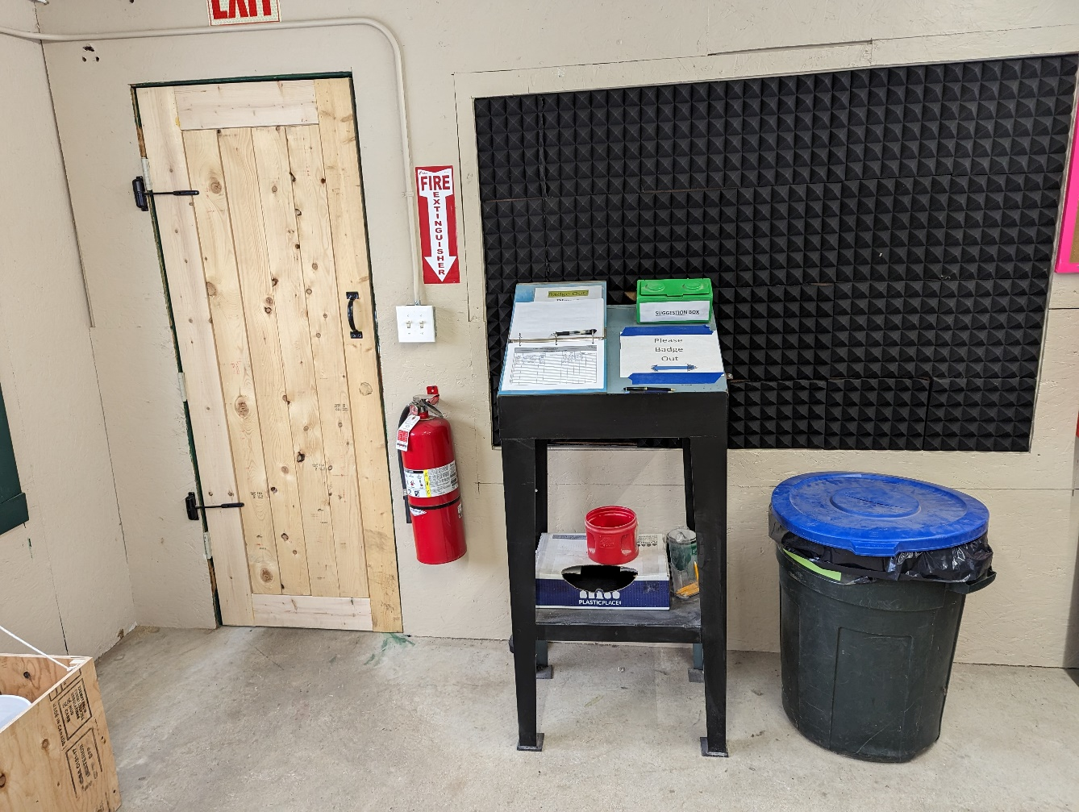
Pistol Range Inside Shooting Room
NOTE: A Copy of these slides, is available for your review, located in the Sign-in desk.
When You Enter The Range…
Light Switches
Sign-in Logbook
Always Sign-In using the Range Logbook and remember to follow the Club’s guest policy.
Sign-Out when leaving and remember to always Badge out!
Fire Extinguisher
NOTE: Always Log your “Number of Rounds & Calibers Shot”

Slide 27
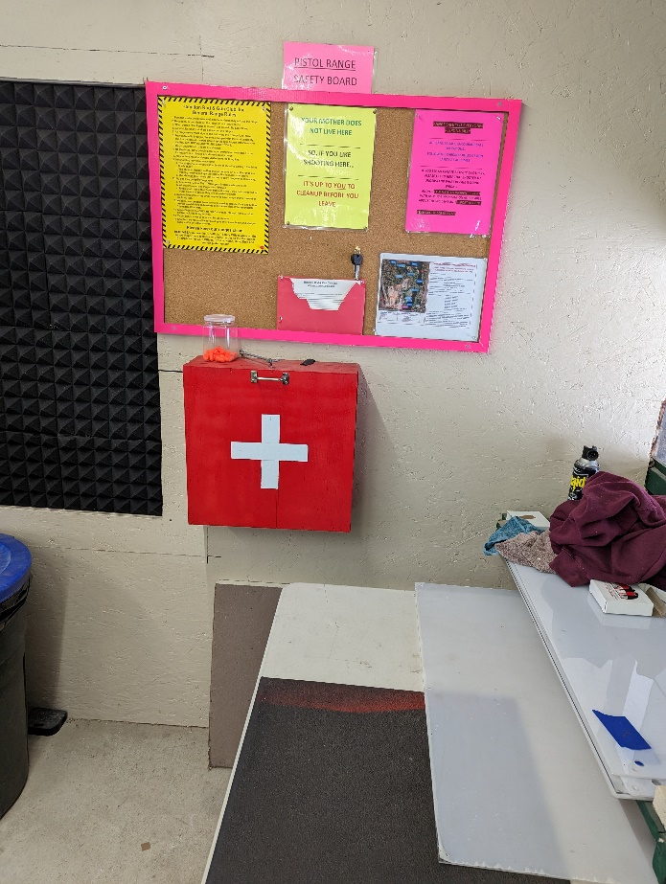
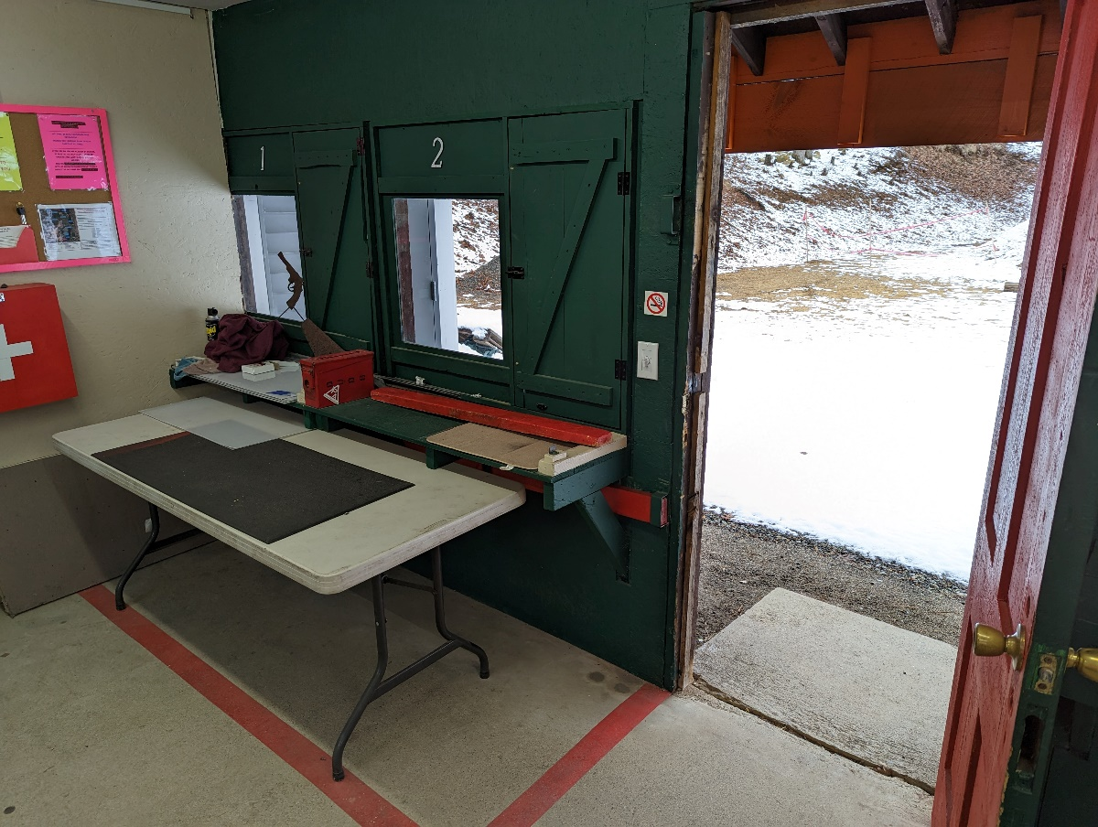
Pistol Range Inside Shooting Room
Shooting Station ID
Safety Board
Safety Area
First Aid
Safety Area
Door to Target Area Open

Slide 28
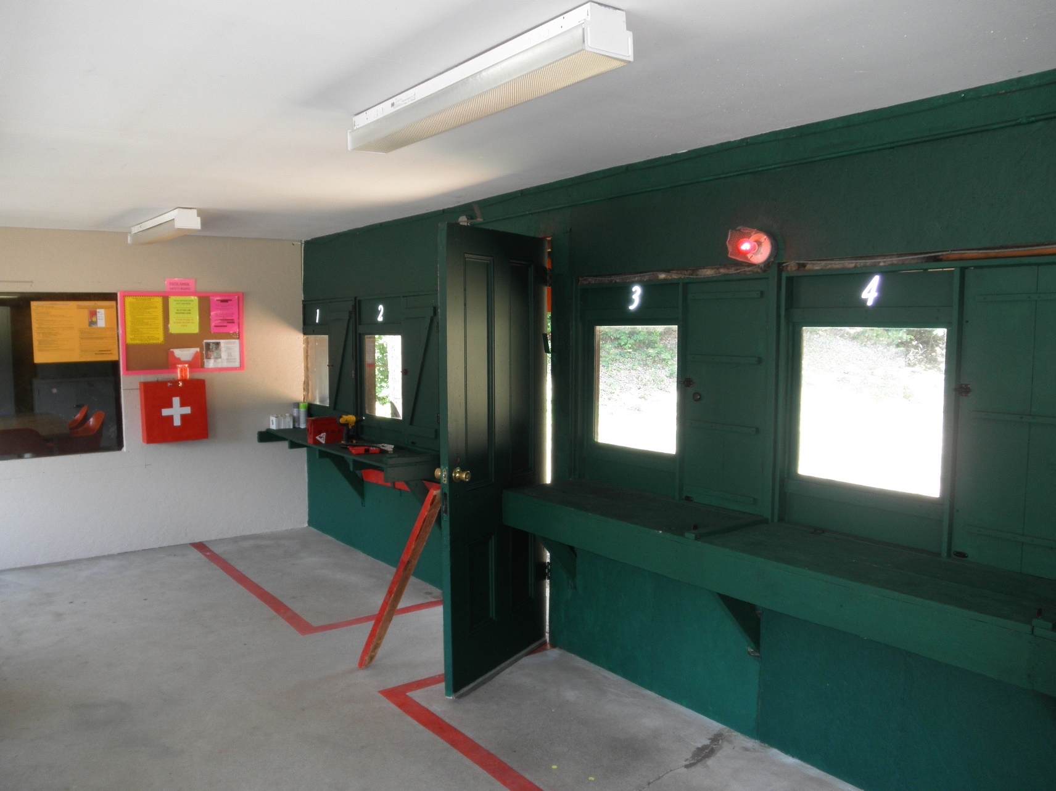
Pistol Range – Layout – Inside
Shooting Station ID
Dud Box – for defective cartridges Only
Door to Target Area Open / Safety Lights On
RED Safety Line
RED Safety Line

Slide 29
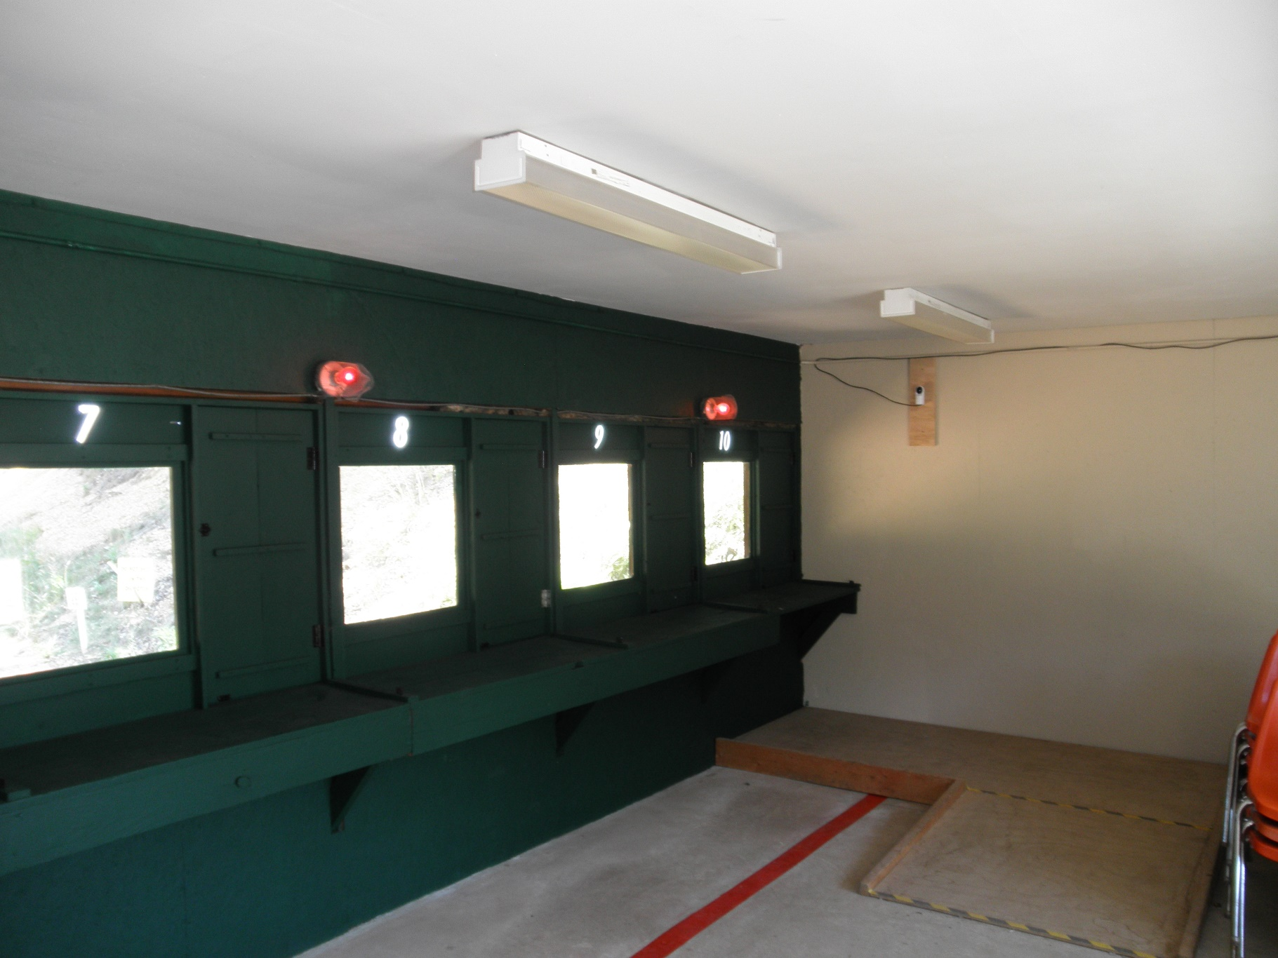
Pistol Range – Layout – Inside
Red Safety Lights Switch (Activates when door is opened)
RED Safety Line

Slide 30
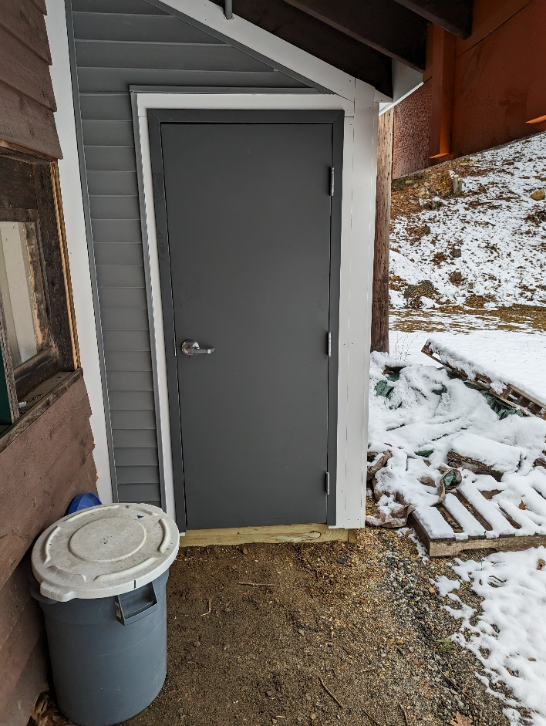
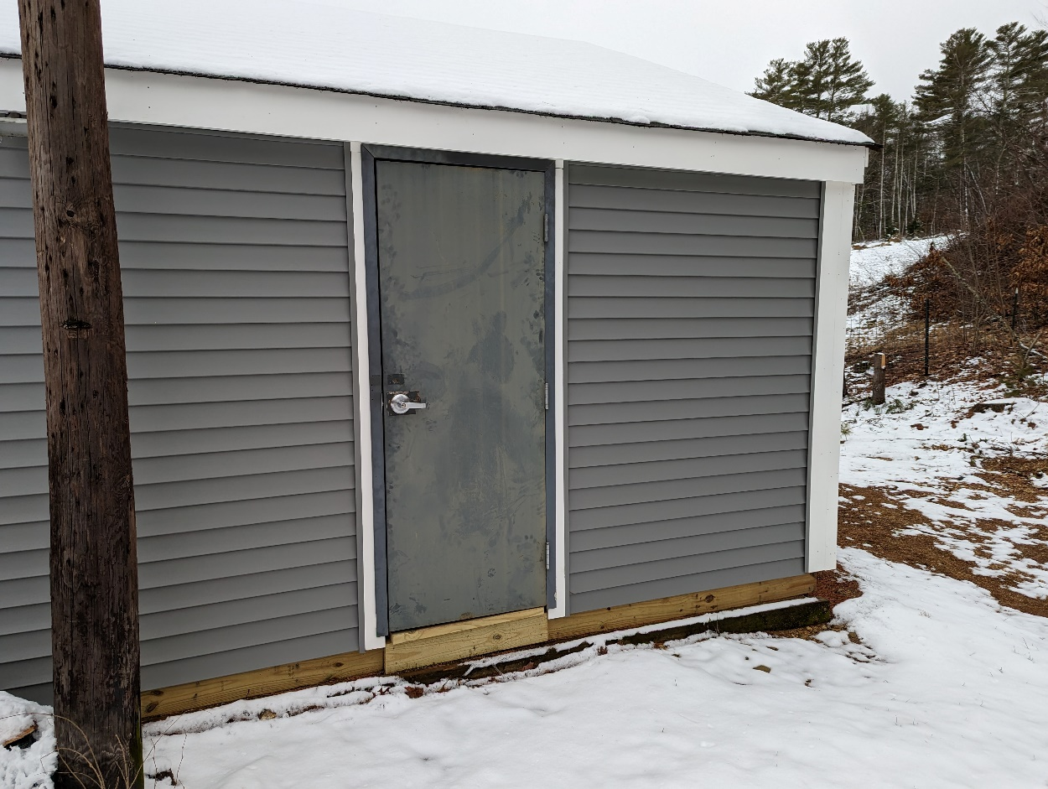
Pistol Range – Storage Sheds
Shed A – Pistol Management
Shed B – Pistol Membership Access

Slide 31
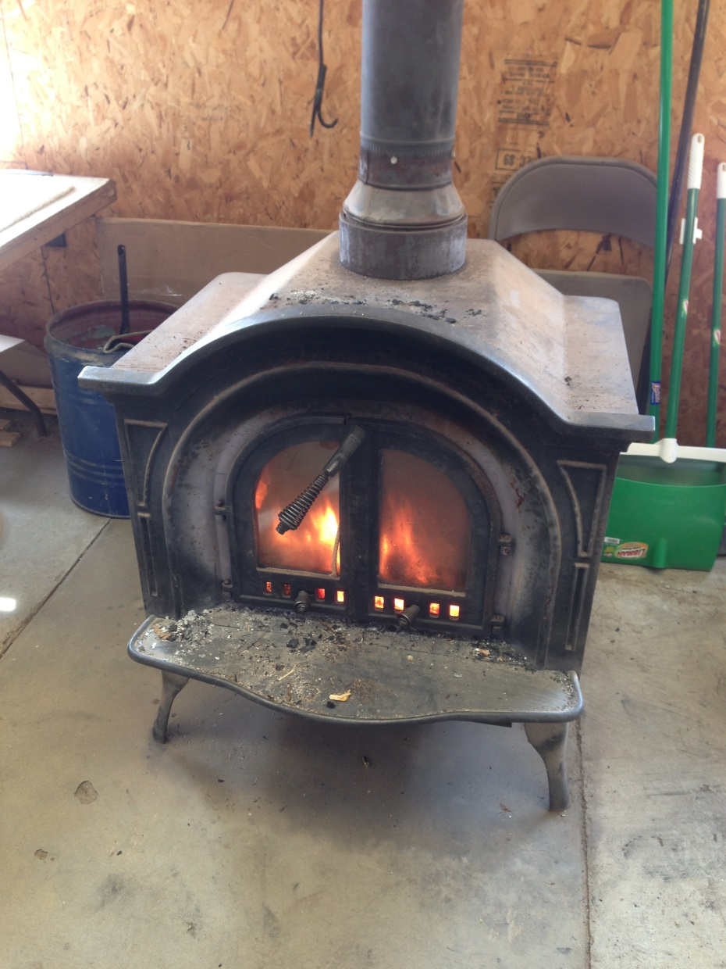
Pistol Range – Layout - Inside
Woodstove
Do Not Throw Dud Rounds In Stove
Make sure woodstove doors are closed before you leave the range.
Leave all logs inside the stove and let it burn itself out. DO NOT take out the logs and put them on the floor!

Slide 32
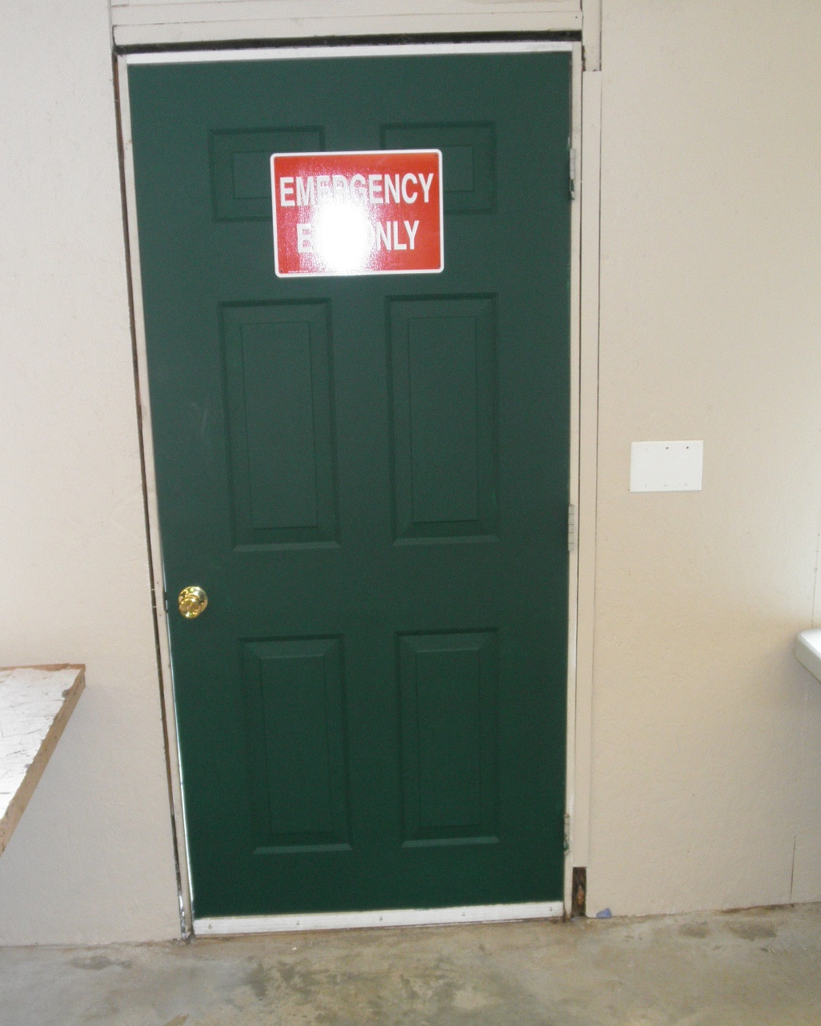
Pistol Range – Layout – Inside
Emergency Exit Door to Parking Lot

Slide 33
Pistol Range – Layout - Inside
Target Frames and Cardboard are not provided, please bring your own.
Target Frame Uprights can be used in the 50’ Target Frame Holder or in the Movable Stands
Make sure your targets and Frames are not located in front of the Steel Targets.
Pickup and place in Trash container all target materials you are not taking with you.
Outdoor Range Light Switches .
Video Camera

Slide 34
Pistol Range – Safety and Shooting Guidance
Gun Safety Rules
Guidance for Novice Shooters
ALWAYS keep the gun pointed in a safe direction.
ALWAYS keep your finger off the trigger until ready to shoot.
ALWAYS keep the gun unloaded until ready to use.
Use a firearm and caliber you can control.
In general, small firearms are harder to shoot well than medium/large sized firearms.
In general, lighter firearms have greater felt recoil than heavier firearms.
Start with a .22LR and increase caliber as you get more proficient.
The Muzzle End of your Firearm must be pointed Down Range at All Times

Slide 35
Pistol Range – Practical/Tactical Style Shooting
The Rule
Explanation
“Practical/Tactical” style shooting is allowed ONLY when shooting from a downrange (outside) position. All Targets must be located directly in front of a berm and in a safe direction of fire.
HRGC defines Practical/Tactical Style Shooting as: Firearm(s) manipulation and/or movements that are required for or specific to defensive/IDPA/USPSA shooting practice and competition.
Examples
Drawing from a holster
Speed reloading
Shooting at multiple, widely spaced targets
Shooting from kneeling/prone/supine positions
Shooting and moving and/or shooting while moving

Slide 36
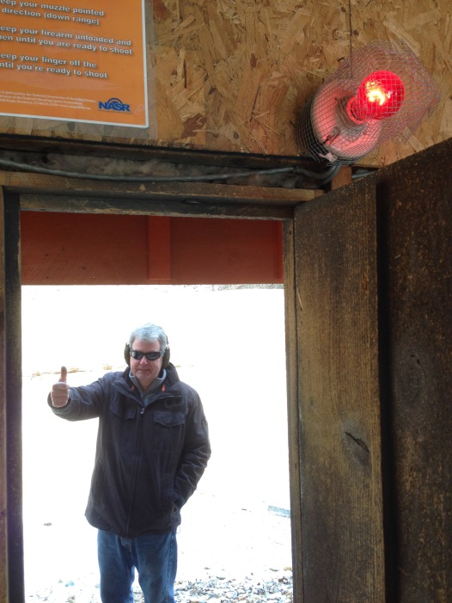
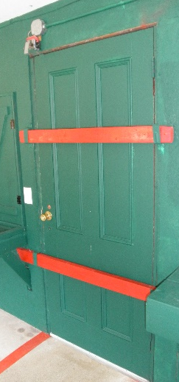
Pistol Range – Going/Shooting Downrange (Outside)
The Rule
The Reason
When going downrange (outside) to change targets or to shoot, etc. the range access door MUST be left open/ajar to illuminate the RED safety lights over the indoor shooting positions.
Alerts everyone that someone is downrange.
Range Door must be OPEN/AJAR to activate Red Safety Lights.
RED Light OFF
Door Closed
RED Light ON
Door Open

Slide 37
Pistol Range – Unloaded firearms
The Rule
Example:
ALL firearms must be open and unloaded before going downrange. It is the shooter’s responsibility to check all guns on the range as well as their own to ensure they are empty.
ALL firearms must remain open and unloaded until it is safe to fire.

Slide 38
Keep Firearm Pointed Down Range At All Times When On The Firing Line
Load Your Firearm only When Pointed Downrange
Your Shooting Window Is Open – You Are Forward Of The RED LINE

Slide 39
Pistol Range – Steel Targets
The Rule
The Reason
For normal shooting - Minimum allowed distance for shooting common free-standing steel targets is 10 Yards (30-feet) from intended firing line to target.
Remember: NO Personal Steel Targets are allowed.
Minimizes possibility of injury and property damage due to bullet debris.
Shooting Steel: No steel target is 100% ricochet-proof so please follow the rules to minimize the possibility of being struck by debris when shooting

Slide 40
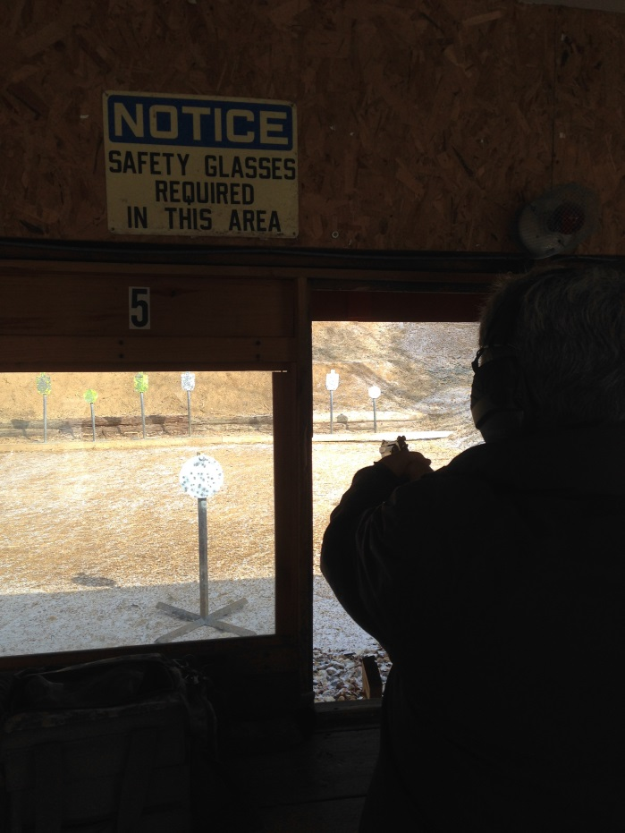
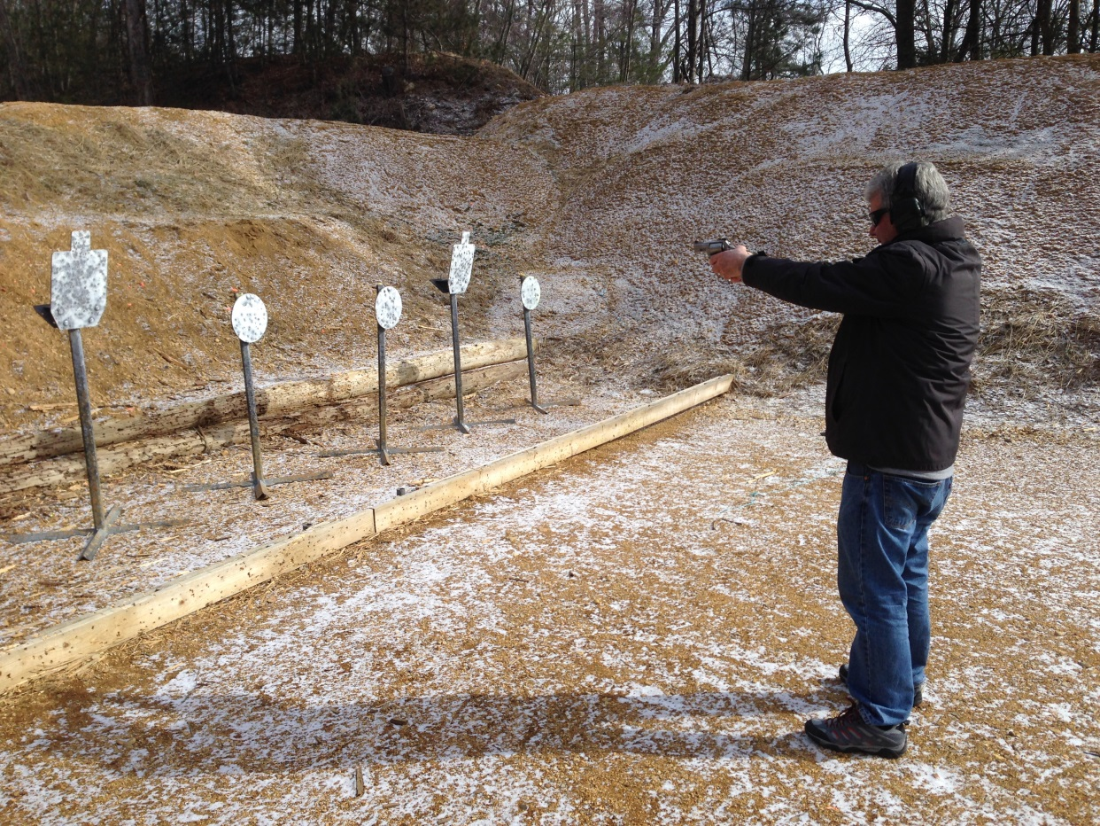
Pistol Range – Steel Targets
Examples
Too Close to Target!
Target also too low for missed shots!
Too Close to Target!

Slide 41
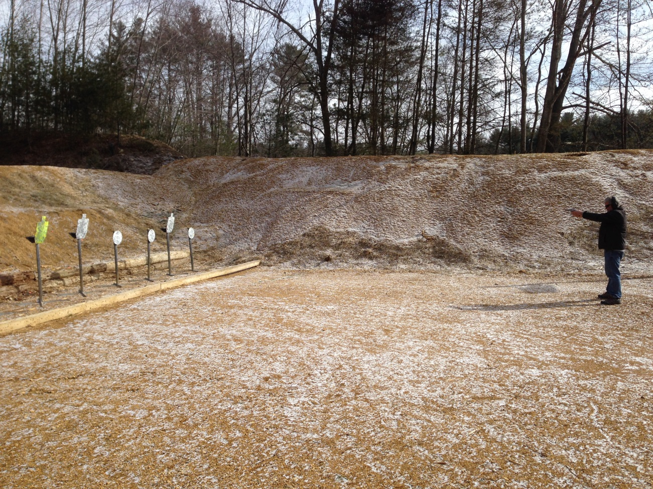
Pistol Range – Steel Targets
Examples
10 Yards is the Correct Minimum distance and target placement for missed shots.

Slide 42
Pistol Range – Targets and Berms
The Rule
The Reason
Use Paper, Cardboard, Clay and Steel targets
No explosive targets
Targets shall be placed so that shots should directly impact a berm.
Use provided target frames or bring your own that are the proper height.
Targets should be positioned at approximately a 4’ – 6’ height.
Do not place targets directly on a berm
Do not walk, climb or bring vehicles onto the berms and backstops
Ensures berms absorb bullet impact.
Prevent ricochets
Minimizes damage to frame holders and berm retainers.
GLASS TARGETS
PLASTIC TARGETS

Slide 43
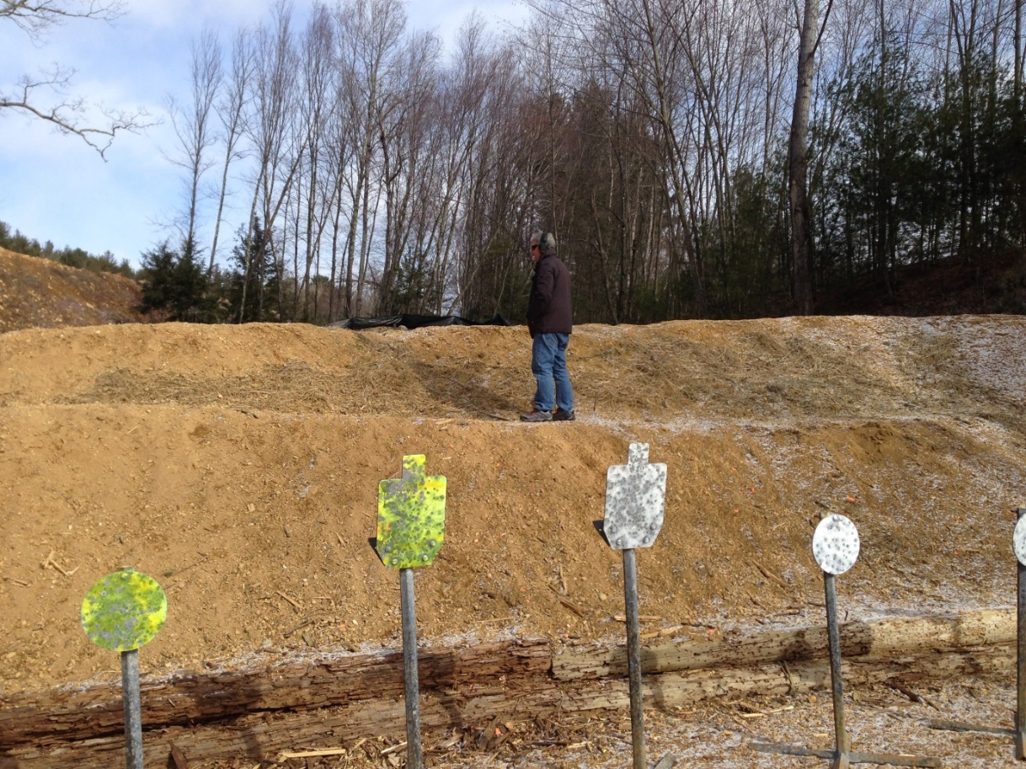
Pistol Range – Targets and Berms
Examples
Do not walk or put targets on the berms.
Prevents erosion
Behind the 50 Foot berm is off limits

Slide 44
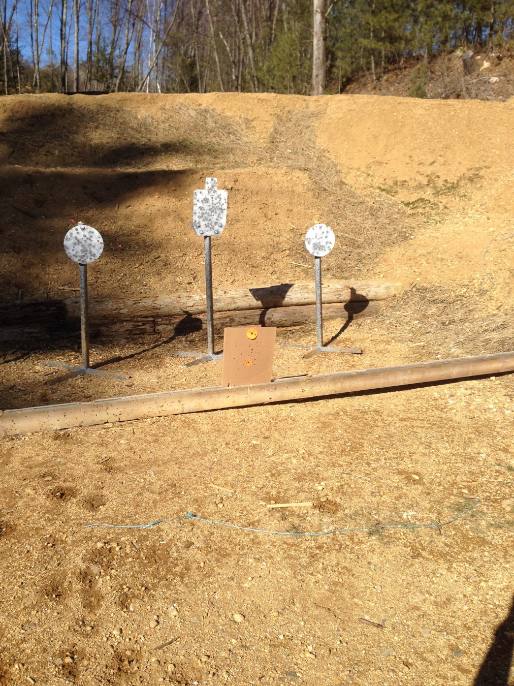
Pistol Range – Targets
Examples
Incorrect. Target is too low and not using the proper target uprights.
Behind the 50 Foot berm is off limits

Slide 45
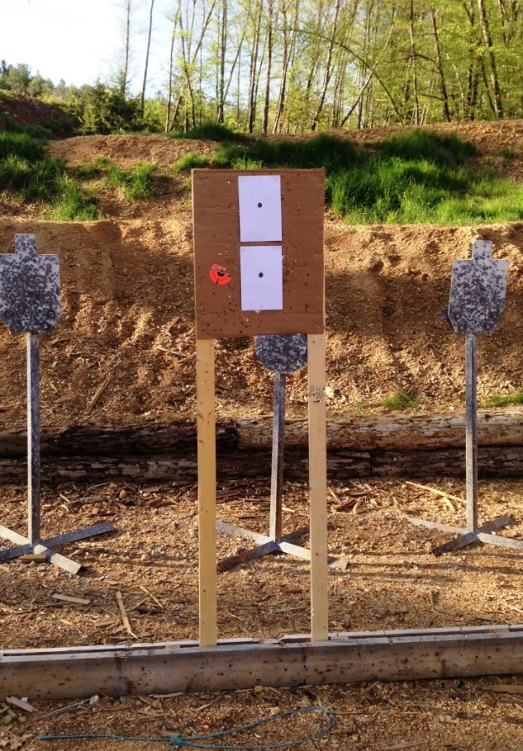
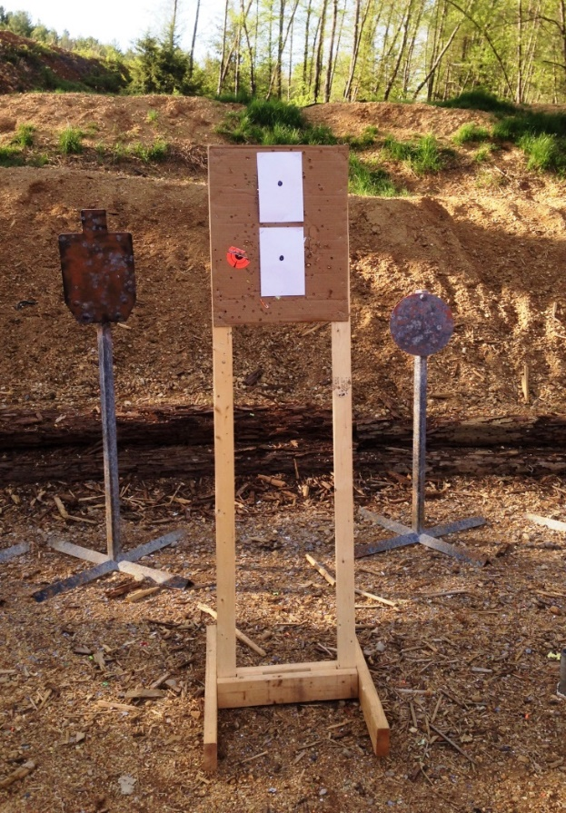
Pistol Range – Targets
Examples
Correct. Targets are at proper height = between 4 – 6 feet off the ground and using the proper uprights and stand(s)
Steel Is Behind Target Stand
No Steel Behind Target Stand

Slide 46
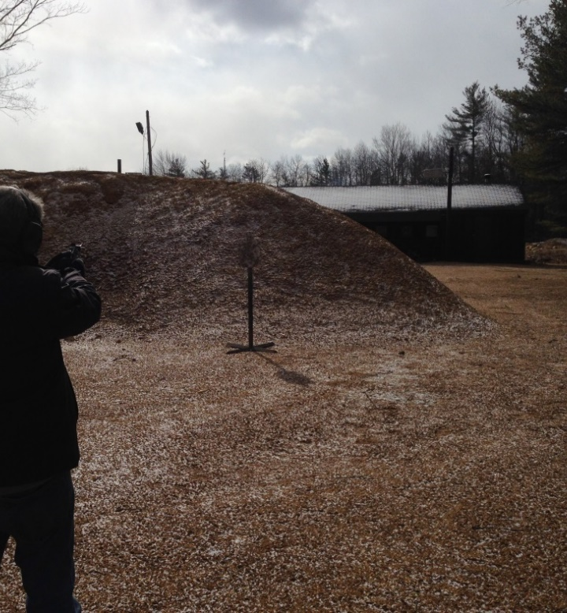
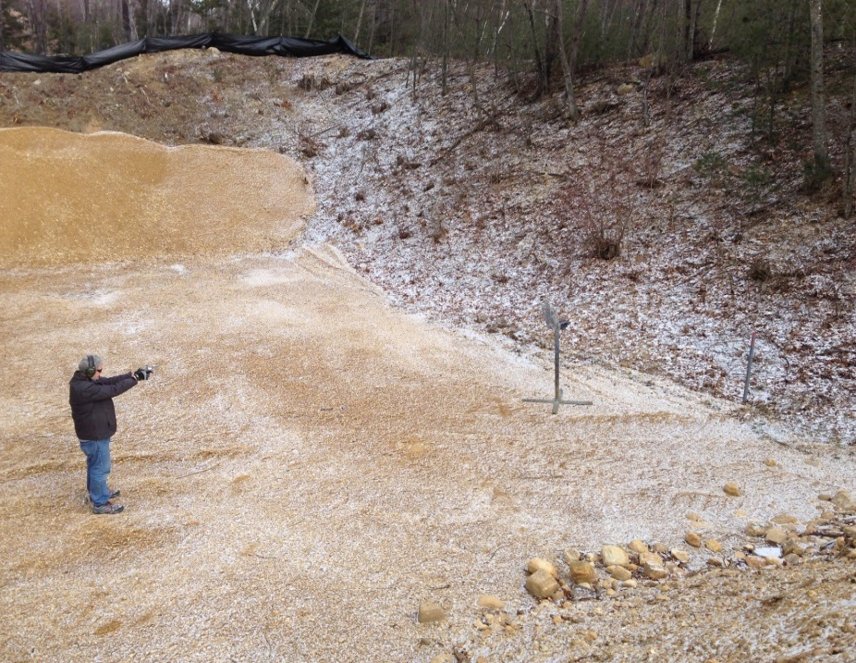
Pistol Range – Directions of Fire (DoF) and Target Locations
Examples of INCORRECT DoF and Target Locations.
Shooting towards the Pistol House.
Shooting toward the right side of the range (toward the Pavillion Bldg).
This Area Is Behind the Berm and is Off Limits

Slide 47
RIFLE range
Rifle Range Layout and Rifle Specific Rules
Rifle Range Abbreviations
Board of Directors - BOD
Concrete shooting Platform - CSP
Red Safety Line – RSL
Open Bolt Indicator – OBI
Range Safety Officer – RSO

Slide 48
RIFLE RANGE
Key Points you need to understand:
Safety is the #1 priority
Gate policy
Muzzle discipline
Open chamber indicators
Approved targets
Target placement
Rate of fire
Use of steel targets
Targets for shotgun use
Shipping container policy

Slide 49
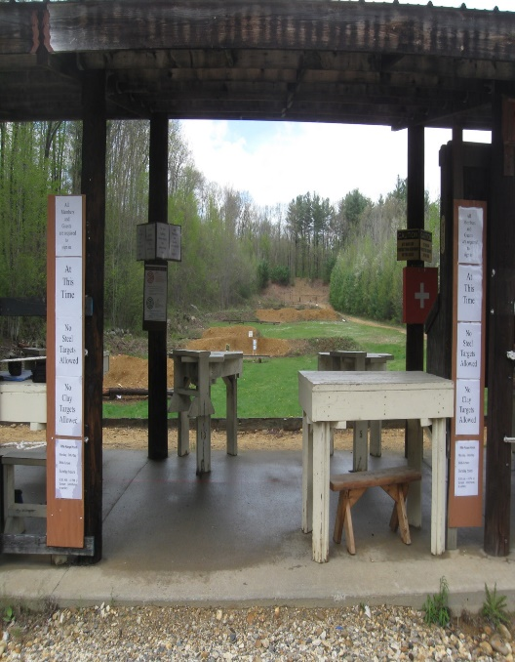
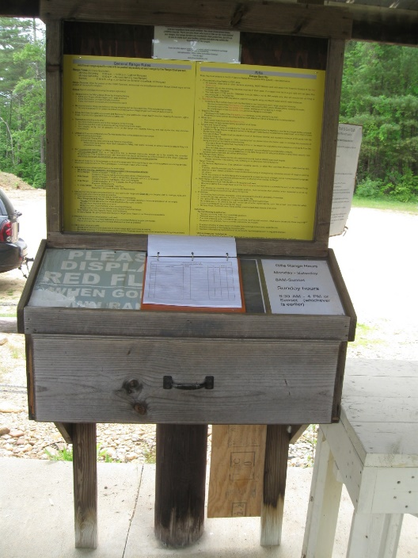
Rifle Range
When you enter the range
Read Posted Signage/Know the Range Rules
Something may have changed from your last visit
Always Sign-In and Sign-Out using the Range Logbook
Log your “Number of Rounds & Calibers Shot”
Observe the surrounding and down range areas for people, vehicles, unsafe and /or abnormal conditions.
Are the RED Strobe Lights Flashing or is the Downrange RED Flag flying?
When you move to Range Sign in station
When you move to the Shooting Area

Slide 50
Safety Tips
While at this Rifle Range, everyone Must wear appropriate Safety equipment at all times – Eye and Ear protection is mandatory.
Maintain muzzle control at all times, especially when entering and exiting the range – don’t sweep people with muzzle
Take a moment to look around and observe for unsafe conditions
Treat all firearms as if they are loaded
Avoid cross range firing, move your location to square up to your target
When sighting in a new gun or optic, start at the first berm to ensure you’ll hit paper as you move your target down range
The RED SAFETY LINE on the “Concrete Shooting Platform” (CSP) is not to be crossed unless the Range is Live / Hot and Strobes / Flags are no longer active and Downrange is Safe.
If a Range Safety Officer (RSO) is available, or responsible for Range activities, such as a Sanctioned Shoot, Firearms Training, or in general command of the range, pay attention to his or her instructions.

Slide 51
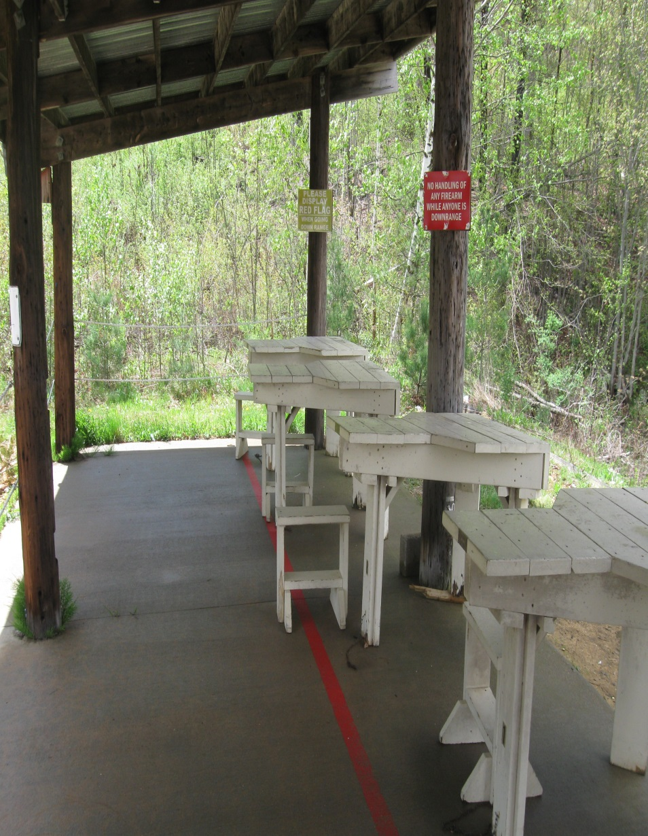
Rifle Range – Concrete Shooting Platform (CSP)
The Rules – 25 Meters out to 100 Meters
Observers and other persons attending, MUST Remain back and away from firearms forward of the Red Safety Line
Firearms not on the shooting benches must be in their case, if uncased they must be in a gun rack with an Open Bolt Indicator (OBI)
The Left Side of the CSP are for distances from 25 meters out to 100 meters only, this will ensure that all firing is perpendicular to the firing line
The Left Side of the CSP may also be used for Handguns, using only the 25 and 50 meter distances

Slide 52
Rifle Range layout – left side of CSP
Strobe

Slide 53
Rifle Range layout – right side of CSP
Strobe

Slide 54
Pistol usage at the rifle range is limited to only the left side of the CSP and only berms 1 and 2

Slide 55
Rifle Range Rules – Rifle Range Impact Berms
The Rules
Berm Distances
The intent of these impact berms is to capture all rounds fired at HRGC approved targets
Do not place targets of any kind directly on the berm
Targets must be placed such that the bullet impacts the berm directly behind the target / stand whether it hits or misses the target
Berm 1 30 yds / 27 meters
Berm 2 58 yds / 53 meters
Berm 3 113 yds / 103 meters
Berm 4 169 yds / 154 meters
Target Rack 223 yds / 204 meters
Berm 5 250 yds / 230 meters

Slide 56
Rifle Range Rules – Range Closures
The Rules
For General Maintenance, Club scheduled shooting events, or other Club activities (Rinehart, UBC opening day, other)
Training – Club Sponsored, Law Enforcement, other
Weather or soil related conditions- road access due to icing or snowplowing, rain/water erosion of range or parking lot, others
NOTE: Any closing of the rifle range that is expected to exceed two hours in length, will be communicated by signage at the gate, and/or email (website/member portal) announcement , by the individual closing the Range

Slide 57
Rifle Range Rules – Down Range of Firing Line Positions
The Rules
Strobe
Shooting down range from the Official Firing Line is allowed
Shooter(s) going downrange MUST activate the RED Strobe Lights prior and during any movement forward of the “official firing line”
Red safety flag is back up method
Any shooter(s) shooting from a down range position, must surrender their position when requested to do so by anyone wishing to shoot from the official firing line

Slide 58
Rifle Range Rules – Prohibited
Prohibited Actions:
No shooting from vehicles, anywhere , unless sanctioned by the BOD and Safety Committee
No Non-Street legal vehicle, i.e. ATV’s, motorcycles, etc.
No Tactical Shooting, unless sanctioned by the BOD and Safety Committee
No targets are to be placed to the right and/or left of bullet impact berms, such that a fired round does not safely impact a subsequent berm behind that target
No Aluminum cans, Glass of any kind, unauthorized Steel or objects of any kind that have not been approved.

Slide 59
Rifle Range Rules – Prohibited ->Tactical Shooting
May only be done in training class or sanctioned event
Precision shooting under improvised field positions
Precision shooting under induced stress conditions, such as mild exertion, timed events (especially those requiring movement into position), fire on comment and similar techniques
Precision shooting at steep departure angles from buildings, towers, and rugged terrain
Precision shooting while engaging moving targets

Slide 60
Down Range Vehicle Safety
The Rules
Ensure no vehicles are down range before you commence shooting
Look and listen to ensure range is not being mowed
Stay on access road unless turning around or for work party
Do not bring vehicles onto the berms and backstops
You are allowed to drive on road for placing targets down range at respective berms

Slide 61
Targets, target stands, and placement
Ensure proper height of stands and targets at the impact point – NO GROUND TARGETS
Hit or miss, must impact a berm!!!
Do not place targets directly on berm
Do not place targets on road
Use approved targets only
The rails /protectors /logs/rocks are not targets!
Bring your own targets / stands – clean them up
Shipping container available for targets and stands steel / paper. $30.00 first year. Reduced fee of 20.00 for volunteers and class attendees.

Slide 62
Rifle Range – Targets and Berms
The Rule
The Reason
Use Paper, Cardboard, Clay and Steel targets
No exploding targets of any kind
Targets shall be placed so that shots should directly impact a berm.
Use provided target frames or bring your own that are the proper height.
Targets should be positioned at height to impact berm .
Do not place targets directly on a berm
Do not walk, climb or bring vehicles onto the berms and backstops
Ensures berms absorb bullet impact.
Prevent ricochets
Minimizes damage to frame holders and berm retainers.
GLASS TARGETS
PLASTIC TARGETS
UNAUTHORIZED STEEL ITEMS

Slide 63
Rifle Range Specific Rules – Target and Target Frames
The Rules
Target holders- either provided by the Club, or duplicates provided by members - are the only target holders allowed
Shotgun shooters must provide their own target frames
Location – Target frames must be inserted in the target frame holders located behind each bullet impact berm. Portable bases allowed provided they are set up properly to impact berm
Any use of Steel targets must be placed in front of the impact berm(s) and located a minimum of 10 yards from the intended firing line for .22LR and 100 yards from firing line for any centerfire catridges
Hit or miss the bullet must impact berm!

Slide 64
100 yard rifle sight in area
Target stands and targets must be of a height to impact berm; whether a hit or miss
Please do not shoot the rails

Slide 65
Steel Target safety and concerns
Inspect targets for damage or unsafe conditions
Bullet velocity must be less than 2850 fps at impact to prevent damage to targets
Center fire steel targets must be greater than 100 yards
Center fire targets minimum 3/8” AR500 steel
10 yard minimum for .22LR
.22LR targets approved materials, steel / commercial
No frying pans, hub cabs, etc.
Do not fire cross range at targets
Shooting pistol at steel targets approved only on training classes or sanctioned events

Slide 66
Steel Target Do’s
Ask the rifle committee, rifle chairs, or safety committee members if you have any questions regarding the use of steel targets
Visually inspect targets for damage, pitting, or unsafe conditions
Ensure targets are mounted at an angle towards the ground to minimize ricochet hazards and maximize target life
Ensure targets are mounted such that they move freely when hit
Portable stands must be constructed to minimize ricochet hazards and set up such that misses impact the berms
Use only AR500 targets, minimum 3/8” thickness

Slide 67
Steel Target Don'ts
Do not use steel core, penetrator, green tip or armor piercing rounds
Do not exceed 2850 fps at point of impact to prevent target damage
Do not engage targets at a distance less than 100 yards
Do not use any targets other than a minimum grade of AR500 steel at a minimum of 3/8” thickness for high power rifles
Do not fire cross range to engage targets
Portable steel targets for pistol use are only allowed for sanctioned training, practices, and club events

Slide 68
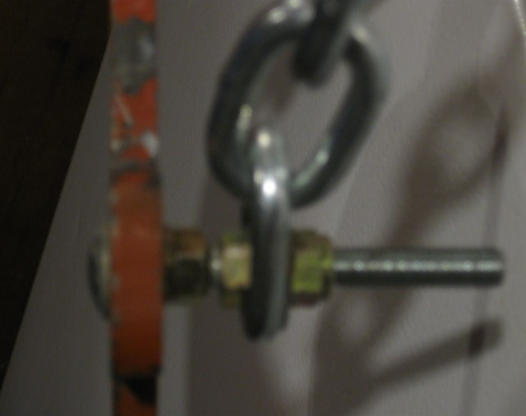
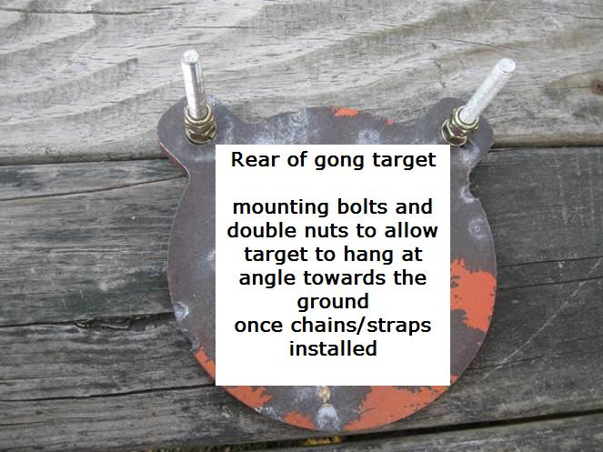
Steel target approved Mounting Hanging devices
Defined as :
Chains, straps, fire hose, strapping, or purchased mounted kits that allow target to be mounted at an angle towards the ground and allows the target to move freely when struck
Chain installed
Rear of target
Target hangs toward ground

Slide 69
Properly mounted portable stand
Constructed and mounted so :
That the portable stand is mounted such that any misses impact the berm.
Constructed to minimize ricochet hazards
Constructed of approved materials and allow the target to move freely when struck

Slide 70
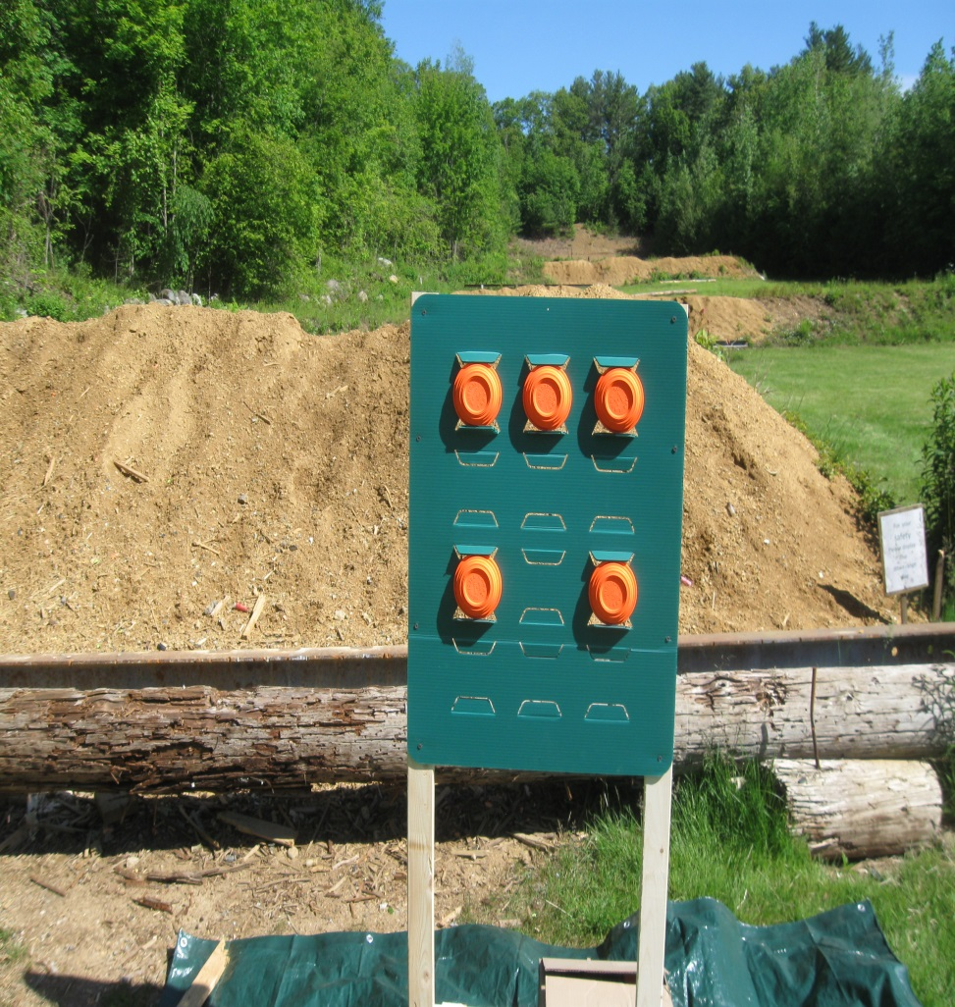
Clay target shooting on the rifle range
No clay targets directly laying on any berm
Stands must be set up such that the bullets impact a berm
Approved clay target stand and a tarp must be placed on the ground to collect debris
Dispose of debris in proper container

Slide 71
SUMMARY: Safe To Shoot?
BEFORE you commence shooting;
Make sure no one is down range or in harm’s way
Announce your intent to shoot by asking if the firing line is ready
Visually verify all persons on or at the range are wearing hearing and eye protection, including spectators
The range is over 250 meters in length, and has multiple berms. If vehicles or equipment are present and no personnel are in sight; walk the range to ensure that it is safe to commence shooting

Slide 72
Summary: things to remember
Be safe and be respectful of the people and property
Something doesn’t seem right, then please report it!
Watch your surroundings - pick up after yourself
Set targets such that hit or miss they impact a berm
Do not fire at targets cross range – move to a safe position
Uncertain of impact, start close and work your way out
Use only approved targets
Directly monitor guests
Before proceeding down range, ensure range is cold
Use RED Safety Strobes when going down range. Flag is fall back method

Slide 73
SUMMARY: Sustaining our ability to shoot
RESPECT the hard work of others, both past and present, our future membership is at stake:
Please be safe!
Report suspect or unsafe conditions
Is that person next to you a member?
Follow the rules for paper, clay, and steel targets
Please volunteer - whether it be work parties, monetary donation, or simply picking up after yourself (and others if needed)
It’s your range, please treat with respect!

Slide 74
Trap range
Trap Range Layout and Trap-Specific Rules

Slide 75
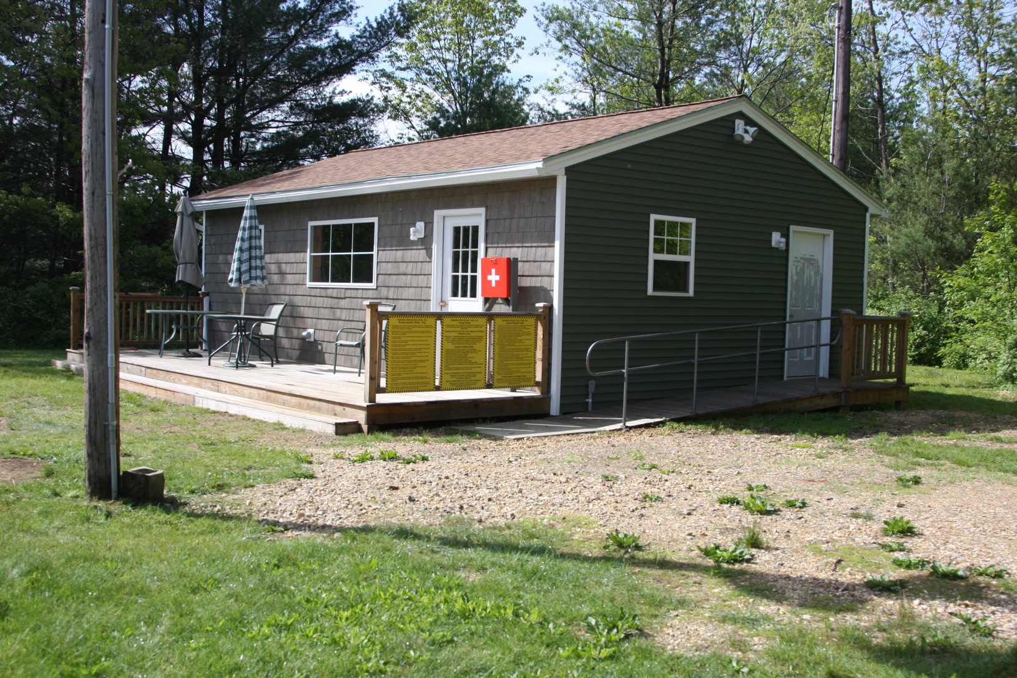
Trap Range – Trap House
Main Access Door
Handicap Access Door

Slide 76
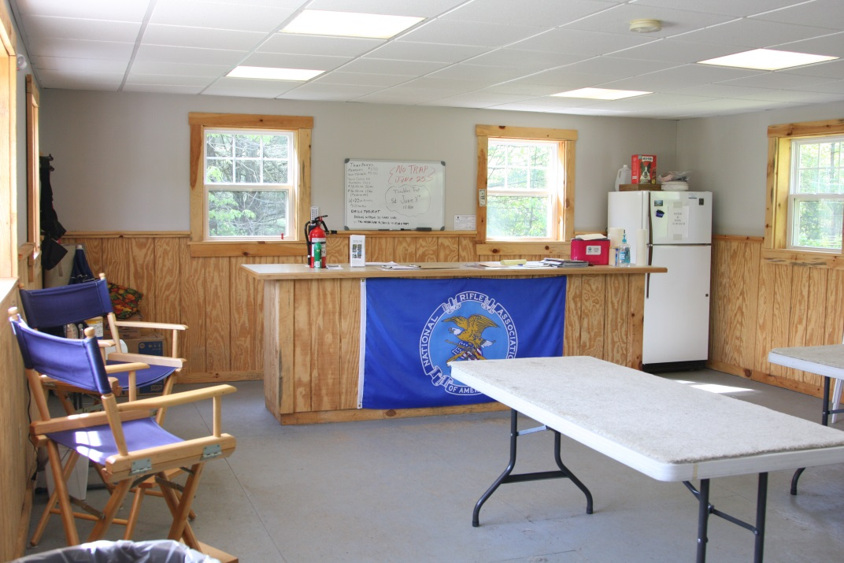
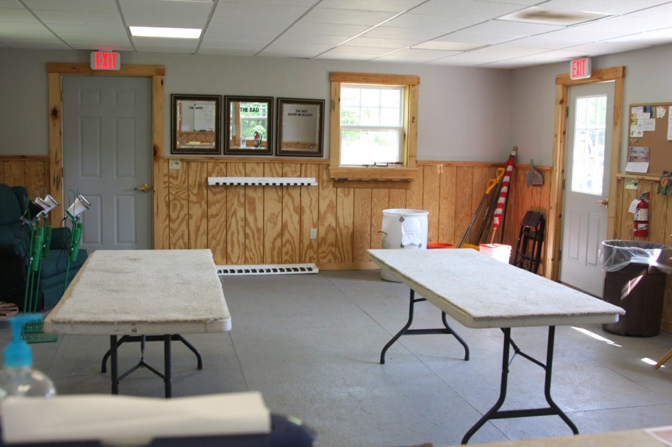
Trap Range – Trap House - Inside
Sign-up / Payment Counter
Tables for your gear
Shotgun rack

Slide 77
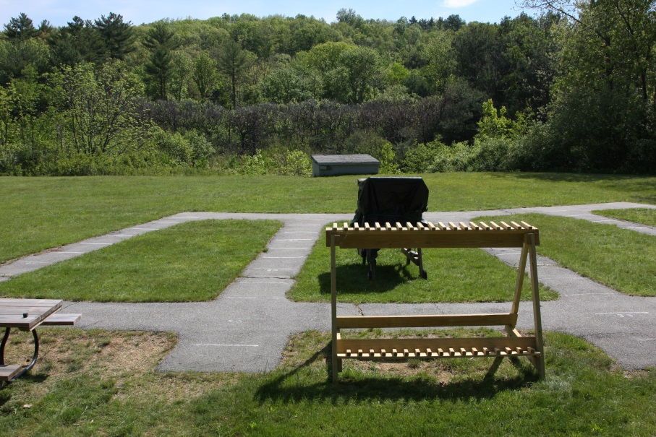
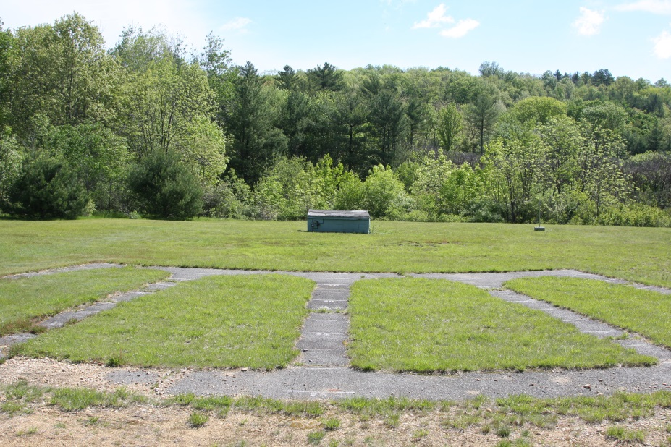
Trap Range – Trap Fields
Main Field
Secondary Field
Trap uses two fields
The field closest to the Trap House is the main field.
The field left of the main field is used if needed.
Trap shoots every other Friday 6:30 – 9PM, and Sundays 9:30 – 12 PM.
The trap fields are available for member use all other times if you bring your own clays, thrower and/or patterning targets.

Slide 78
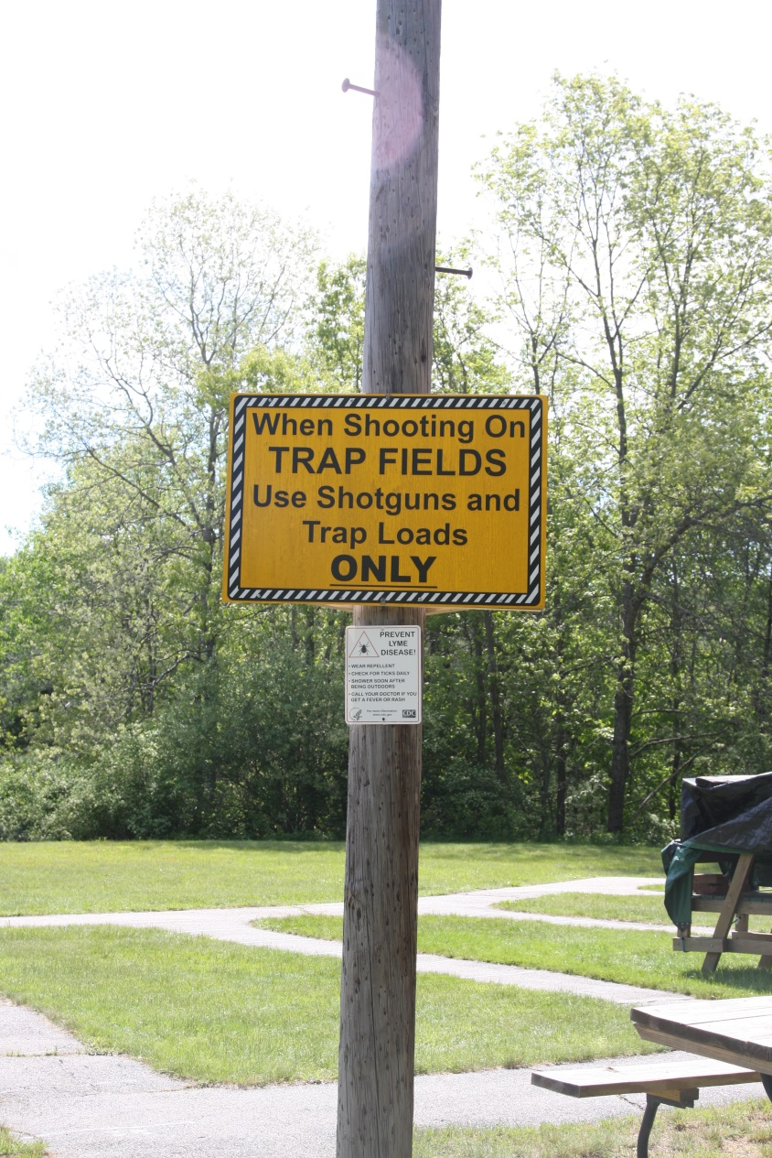
Trap Range – Ammunition and Shotguns
Only Trap/sporting loads up to 3 dram equivalent can be used on the trap fields (#7-1/2 , #8 and #9 shot only)
No high brass, magnum loads or slugs allowed
Only shotguns of 12 gauge or less are allowed

Slide 79
Trap Range – Rules.
All firearms must remain unloaded until the "scorer" or Range Officer determines the squad is ready. "Loaded" is considered as putting a live round in the chamber and then closing it
Shooters while not on a shooting station will carry the firearm with the breech open and unloaded. Pumps and semi-automatics will have the bolt open and unloaded.
Test shots will not be permitted without the permission of the "scorer" or Range Officer.
Shooters must stand with both feet within the boundaries of the designated shooting station.

Slide 80
Trap Range – Rules..
All non-shooters and spectators must remain behind the scorer during the course of fire.
Instructors must notify the "scorer" or Range Officer if they will be assisting and/or instructing during the course of fire.
All shooters on a squad must have their own shotgun - no sharing or passing around of shotguns is allowed.
Only one shell at a time will be loaded, two shells may be loaded when shooting a doubles course.

Slide 81
Trap Range – Rules…
A shooter must not interfere with preceding or following shooters by raising their shotgun or otherwise creating a distraction.
Any discrepancy in scoring of a lost bird will be decided by the squad as a whole.
In the event of a malfunctioning firearm the remaining squad members shall make their firearms safe while the shooter clears the malfunction.
No shooters are allowed on the firing line during re-supply of the trap equipment. A "Red" cone atop the trap house will be displayed.
Each shooter is responsible to ensure his hulls do not remain at the shooting station at the end of each round.

Slide 82
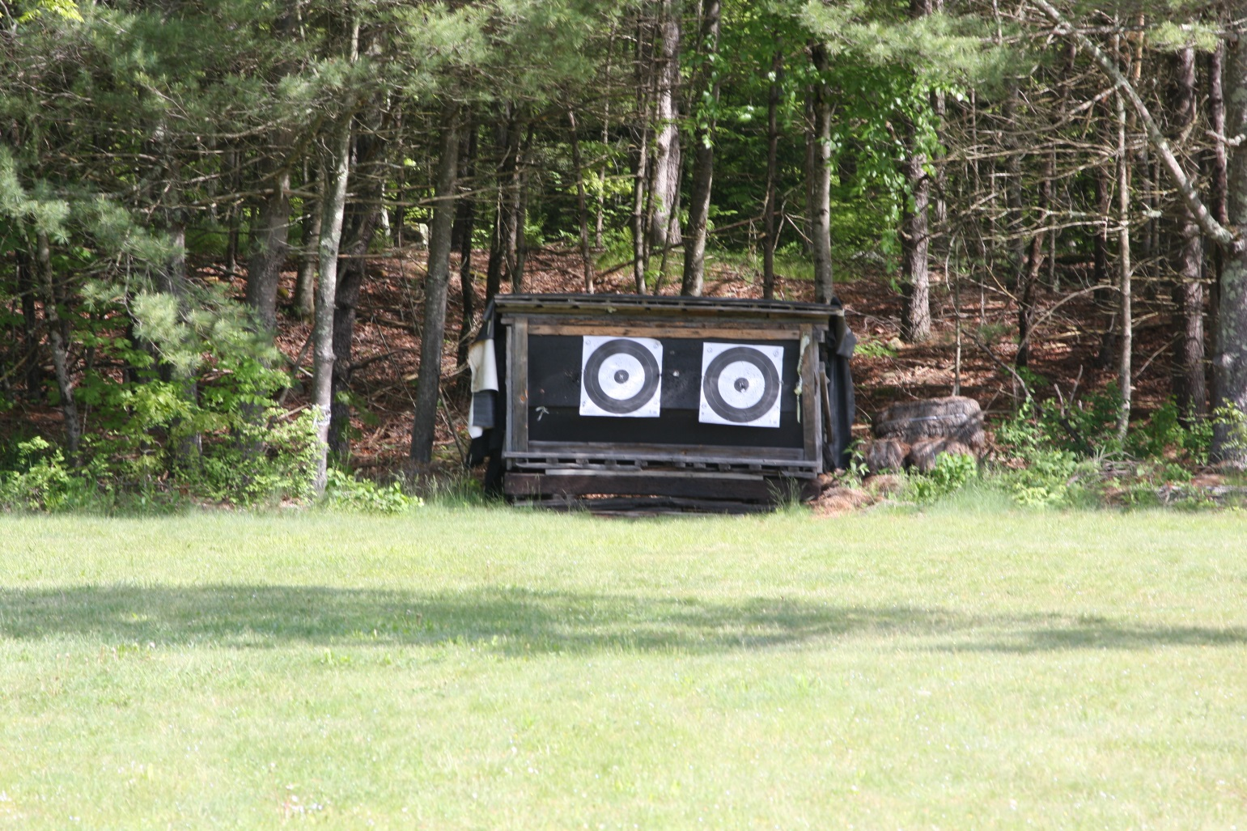
Trap Range – Archery Targets
The targets at the north end of the trap range are not to be used for any firearms shooting. This is for ARCHERY ONLY.

